Slide 1
Behavior Driven Development (BDD) A Case Study in Healthtech
SOFTWARE QUALITY CONFERENCE
PACIFIC NW
Le Xiao, Mihir Kavatkar 10/15/2019
PNSQC ™
Notes:
Good afternoon….
BDD a case study in healthtech. My name is Mihir Kavatkar and I am a full stack developer at Alzheimer’s Therapeutic Research Institute of University of Southern California.

Slide 2
USC ATRI - Mission
SOFTWARE QUALITY CONFERENCE
PACIFIC NW
https://keck.usc.edu/atri/
USC ATRI is an academic organization leading a consortium dedicated to the acceleration of therapeutic interventions for Alzheimer’s disease (AD)
PNSQC ™
Notes:
As we mentioned, we work for Alzheimer’s therapeutic research institute which is a part of Keck school of medicine under the umbrella of University of Southern California.
USC ATRI is an academic organization that takes a lead in accelerating therapeutics intervention for Alzheimer’s disease.
The guiding principles of ATRI are collaboration and data sharing to advance the field of AD therapeutics.

Slide 3
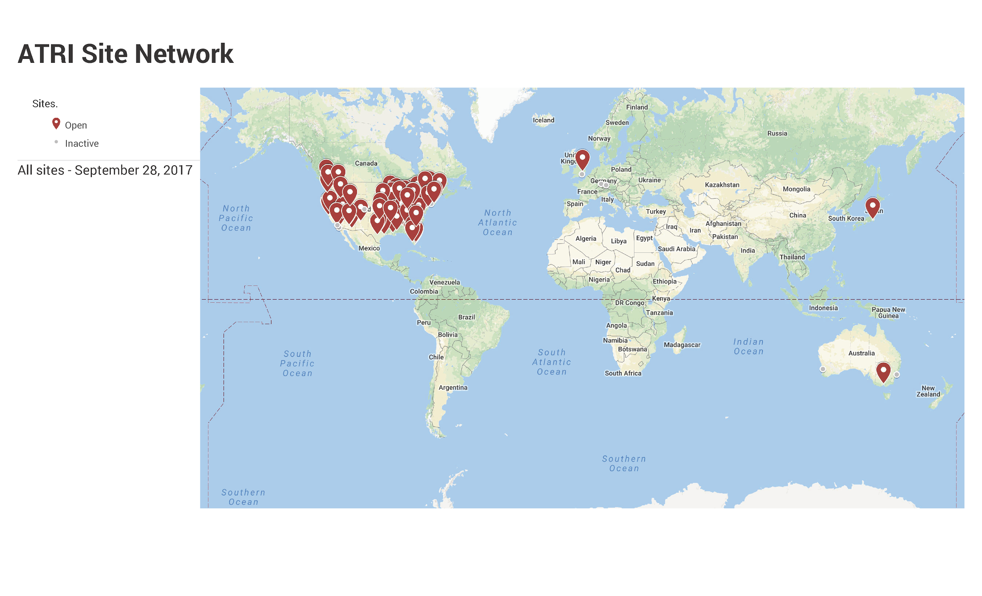
USC ATRI – Global Scale
SOFTWARE QUALITY CONFERENCE
PACIFIC NW
18
Clinical Trials ongoing worldwide
PNSQC ™
Notes:
Quick facts about us:
We are involved in 18 Clinical trials worldwide and that is our coverage of Clinical trials sites.
Finally, We are located in San Diego, California.

Slide 4
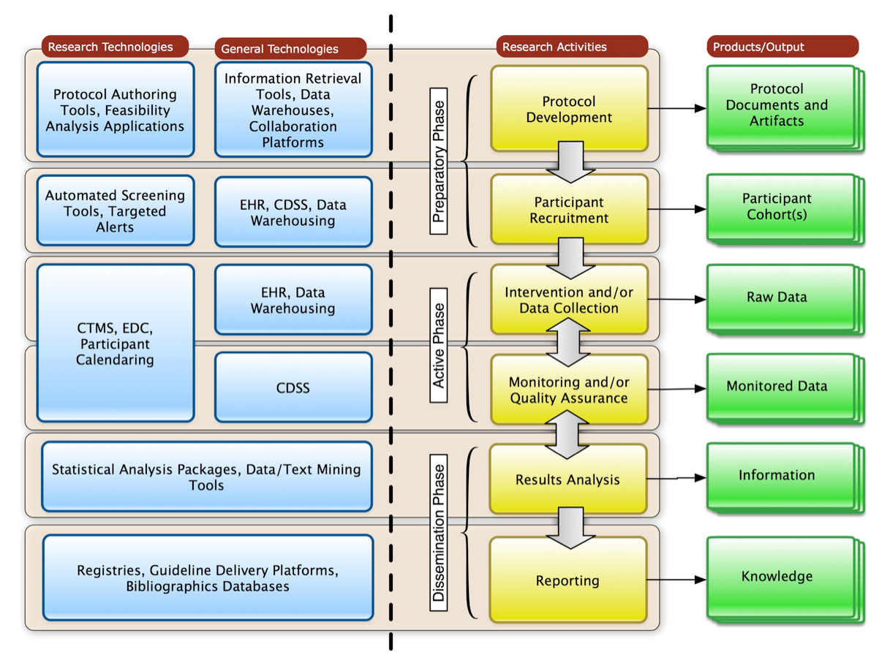
What is a Clinical Trial?
SOFTWARE QUALITY CONFERENCE
PACIFIC NW
PNSQC ™
Philip R.O. Payne - Translational Informatics: The "Glue" Between Basic Science and Clinical Research
Notes:
Now now you know what we do in a bird’s eye view.
Lets jump in a little bit. What is a clinical trial?
This diagram shows the complex processes involved in a clinical trial.
A clinical trial is a complex process of testing new therapies.
A lifecycle of a clinical trial starts with
Defining the goal of the clinical trial i.e. the therapy to be used, followed by the drug to be used for the therapy (this is where the phara. Companies come into picture.)
To publishing the data after completion of trial.

Slide 5
New Drug Development Facts
SOFTWARE QUALITY CONFERENCE
PACIFIC NW
New drug development is a high-risk endeavor
Success rate: 12%
Capital intensive: $2.6 billion (2013 dollars)
Time consuming: Approx. 96.8 months
PNSQC ™
DiMasi, Grabowski and Hansen 2016 - Innovation in the pharmaceutical industry: New estimates of R&D costs.
Notes:
New drug development is a high risk endeavor
with a success rate of 12%. It is very capital intensive and time consuming.

Slide 6
USC ATRI - Informatics Unit (Our Team)
SOFTWARE QUALITY CONFERENCE
PACIFIC NW
Mission
To provide the vision and leadership in Clinical Research Informatics to advance ATRI’s scientific mission
Build innovative computing and data
infrastructure
Developing innovative platforms
APT Webstudy (www.aptwebstudy.org)
ATRI Electronic Data Capture System (EDC)
PNSQC ™
Notes:
Now you know what we do. Let me talk a little about our team,
We work with the informatics team whose mission is to provide vision and leadership in building computing and data infrastructures for operational needs of USC ATRI.
We are a small team with a faced paced environment.
Currently we are involved in two main project:
Alzheimer’s Presevtion trials (APT Webstudy) and ATRI’s electronic data capture system and we will look at EDC for today’s case study.

Slide 7
ATRI EDC
SOFTWARE QUALITY CONFERENCE
PACIFIC NW
Serves as the central repository for study data
Avoids data sprawl across multiple systems
Empowers study teams to manage data flow via single system
Enforces comprehensive data quality standards across multiple data types
Data is isolated across studies to ensure security and integrity
User-centered UX design improves data quality and reduces cognitive burden on users
PNSQC ™
Notes:
ATRI EDC is a central repository for a clinical trial. It is a one stop shop for managing a clinical trial.
Over the years, we have learnt a lot while developing the EDC. We lauch one instance per clinical trial to achieve data isolation
And implementing multiple computer science techniques to ensure security and integrity.
Finally we develop the EDC such that it has less cognitive burden on end users which results in less errors and higher quality data.

Slide 8
ATRI EDC Capabilities
SOFTWARE QUALITY CONFERENCE
PACIFIC NW
Data Collection
eCRFs
Study Documents
Data Processing
Randomization
Data Validation
Medical Coding
Data Analytics and Reporting
Safety
Audit Trail
Data Integrations
Data Export
Study Management
eCRF Design
Data Validation Rules
Study Schedule
User Roles and Permissions
Data Quality and Flow
Event-driven Notifications
Queries
Reports
Imaging
Audio
PNSQC ™
Notes:
These are a few capabilities of the the EDC system across the following categories
Data collection, data processing, analytics and study management.

Slide 9
ATRI EDC Data Standards & Regulations
SOFTWARE QUALITY CONFERENCE
PACIFIC NW
ATRI EDC is subject to multiple Federal regulations
Focus on data Quality, Security, and Compliance
21 CFR Part 11 compliant (Jan 2018)
Record keeping requirements
Good software engineering practices
Risk management
Audit trailing
HIPAA compliant (Dec 2018)
PNSQC ™
Notes:
ATRI’s EDC is used for clinical trials which puts multiple regulatory compliances like
21 CFR part 11 compliance and HIPAA.
Today we will consider 21 CFR part 11 guidance in a nutshell talks about using good software engineering practices,
record keeping requirements like for example using electronic signature for a crucial change that can be tracked in a full workflow.
Or using ticketing system. Requirements of putting operating procedures in place for risk management and finally audit trailing capability
Which describes that every action in the system should timestamped and be traceable back to the user.
Now how do you should compliance for such a requirement for a EDC system.

Slide 10
What is Validation?
SOFTWARE QUALITY CONFERENCE
PACIFIC NW
Validation is a formal, evidence-based process of testing a system in the context of its intended use
PNSQC ™
Notes:
“Validation”
Validation can have various meaning across different industries and systems.
In terms of ATRI’s EDC system, validation is a formal evidence based process of testing a system in the context of intended use.
What does that mean?
e.g. how to show evidence in role based security
A ’X’ user with a ‘Y’ role in the system can only have read privileges.
Originally we had a manual process to achieve it which allowed us to validate the system but it was very costly, error prone and most importantly non reproducible.

Slide 11
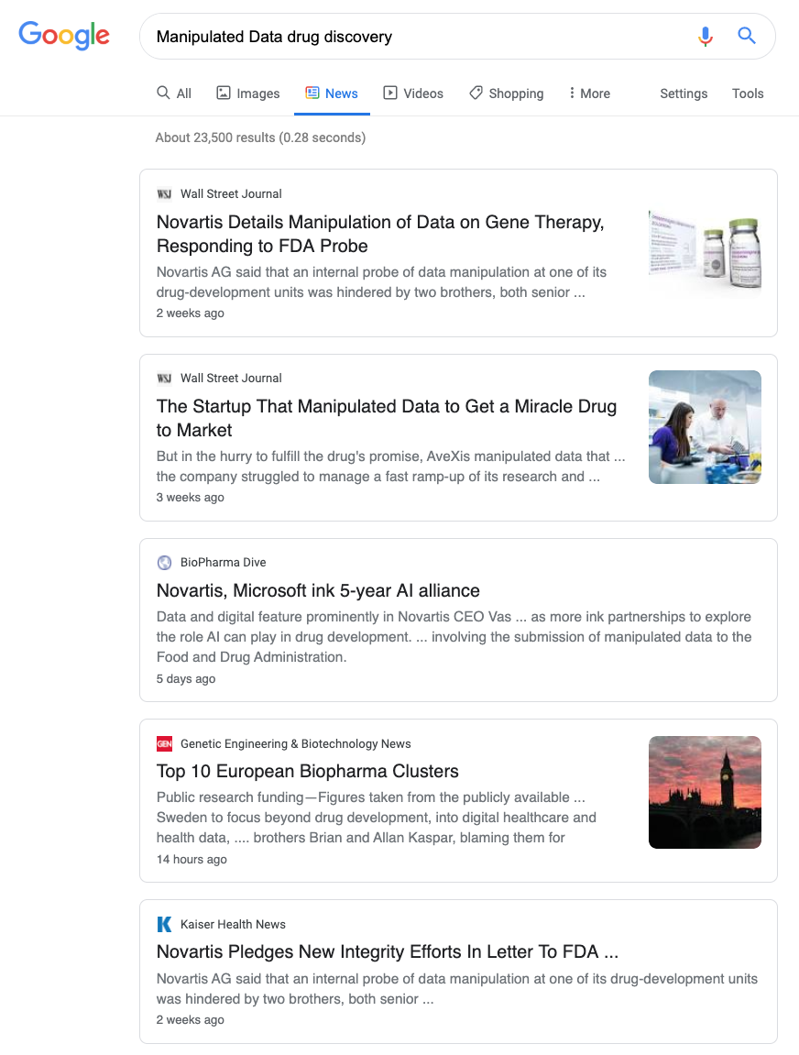
Why is validation important in our industry?
SOFTWARE QUALITY CONFERENCE
PACIFIC NW
Data integrity = Public trust in Science
PNSQC ™
Notes:
https://www.nytimes.com/2019/08/06/health/novartis-fda-gene-therapy.html
Now lets talk about why validation is so important. I just search the following in google which gave the following result.
Data manipulation is the biggest issue to manage for a system that holds data integrity and quality to upmost importance.
And plus you gain public trust !!

Slide 12
Validation Challenges
SOFTWARE QUALITY CONFERENCE
PACIFIC NW
Manual
Costly (human hours)
Error prone
Non Reproducible
PNSQC ™
Notes:
Originally we had a manual process to achieve it which allowed us to validate the system but it was very costly, error prone and most importantly non reproducible.

Slide 13
Behavior-driven development (BDD)
SOFTWARE QUALITY CONFERENCE
PACIFIC NW
Writing a feature
BDD
Refactor
Write a failing test
TDD
n cycles
Make the test pass
PNSQC ™
Notes:
The solution is Behavior driven development. It compliments our current development workflow of using Test driven development strategy.
Basically you write a failing feature test and then refactor the code to pass it.

Slide 14
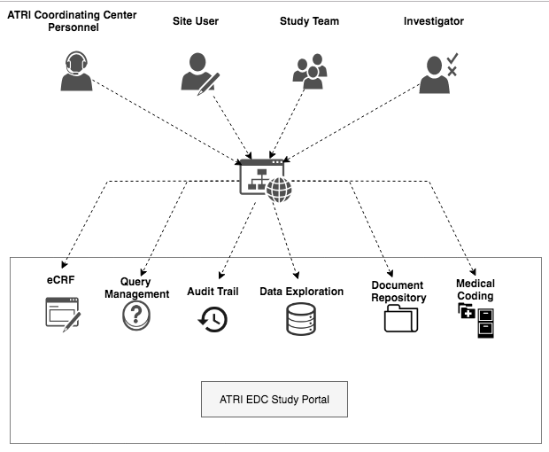
Behavior-driven development (BDD)
SOFTWARE QUALITY CONFERENCE
PACIFIC NW
BDD is an agile software development methodology
Encourages collaboration between
Developers
Software quality engineers
Business analysts
Non-technical stakeholders
PNSQC ™
Notes:
Incorporating BDD has many advantages one I would like to call out is the transparency between the stakeholders and the developers.
For requirements, development and testing.
So, to summarize,
We have a system that collects clinical trials data which is subject to a regulatory compliance.
We had a manual process with a lot of challenges and BDD is our holy grail to solve our problems.
How did we do it? My colleague Le will go through it.

Slide 15
USC ATRI - Behavior Driven Development
SOFTWARE QUALITY CONFERENCE
PACIFIC NW
PNSQC ™

Slide 16
BDD Functional Requirements
SOFTWARE QUALITY CONFERENCE
PACIFIC NW
Improve Traceability
Automate report generation
Minimize disruption of SDLC process
Automate maintainability across multiple releases
Visibility and One-stop-shop
Keep the overall system lean
Ensure Security
Cost-effectiveness and Total Cost of Ownership
PNSQC ™

Slide 17
BDD Technical Requirements
SOFTWARE QUALITY CONFERENCE
PACIFIC NW
Infrastructure around cloud services
Incorporate in development workflow
Ensure readability and maintainability
Accommodate the Gherkin Structure
Ensure granular test running control
Support version control
Debug and refactor code
PNSQC ™

Slide 18
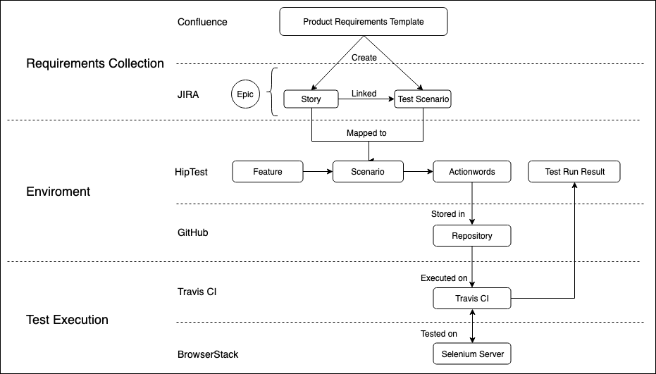
BDD Infrastructure Overview
SOFTWARE QUALITY CONFERENCE
PACIFIC NW
PNSQC ™
Notes:
1. We modulate the infrastructure so that we are able change the settings if we want to change anything in different section. (ex: change from saucelab to browser because it is too slow, the changing didn’t affect our current stack). I will explain what we did in each section in following slides

Slide 19
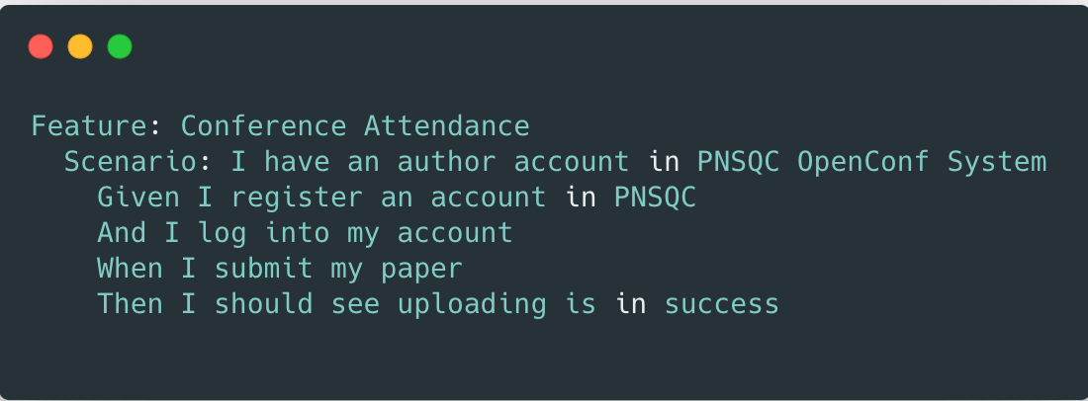
SOFTWARE QUALITY CONFERENCE
BDD Requirements Collection - Infrastructure
PACIFIC NW
Feature
Conference Attendance
Story
I attend PNSQC
Scenario
I have an author account in PNSQC OpenConf system
Step
I submit my paper in PNSQC OpenConf system
Business oriented descriptions
Human-readable test cases
Document intended behavior of system
Executable scripts
PNSQC ™

Slide 20
BDD Environment – Plugin Architecture
SOFTWARE QUALITY CONFERENCE
PACIFIC NW
Feature Files | Feature files are the entry points to the tests. These files describe the scenarios and the steps that are required to accomplish the test. The HipTest command line interface (CLI) helps to build a set of feature files.
Step | A step is a user behavior description. In the plugin, it builds a mapping between a step described in a feature file and implementations which are referred to as action words.
Action Word | An action word is a set of actions taken to implement user behaviors. Developers use an action word to define the logic of the test
Page Object | The page object is collection of DOM elements that are captured from web pages and used to perform user behavior.
Fixtures | A fixture is a collection of pre-defined sample data that can be used to support development and testing
PNSQC ™

Slide 21
SOFTWARE QUALITY CONFERENCE
BDD Test Execution – Parallel Testing
PACIFIC NW
Cross-browser testing platform
Test compatibility
Test user behavior in different browsers
Collect video-based diagnostics
Parallel test execution
Reduce manual work
Accelerate development
Increase reliability
PNSQC ™

Slide 22
SOFTWARE QUALITY CONFERENCE
BDD Test Execution – Parallel Testing
PACIFIC NW
Setup Environment: i.e. Chrome on Mac
Run test 1
...
Run test N
Generate report
...
Generate report
PNSQC ™
Notes:
We know that headless mode is way faster than headful running. The reason why we don’t choose headless mode (puppeteer) to run tests is that we want to mimic user behaviors and see exactly what’s going on the page. Moreover, it’s easer for us to debug the tests, headless mode can be hard for us to debug

Slide 23
SOFTWARE QUALITY CONFERENCE
BDD Reporting – AWS
PACIFIC NW
PNSQC ™
Notes:
At the last job in last stage of Travis CI, we use api of confluence, jira, travis, hiptest to generate report
As time goes by, we are going to have a lot of tests and we need ability to navigate the testing data. In order to access historical data and contain large amount of reports, we are planning to utilize AWS Service to enhance scalability

Slide 24
SOFTWARE QUALITY CONFERENCE
BDD Lessons Learned
PACIFIC NW
Feature
Limitations
Gherkin language constrains human language (Given, Then, And)
Top-down structure; doesn’t support conditional logic
Limited compatibility of web driver and Selenium
Better collaboration
Transparency
Reproducible
Save time and cost
Highly automated
Compliance
PNSQC ™
Notes:
It helps multiple teams agree on a standard for formalizing the test requirements which are used to automate testing and document generation,

Slide 25
Our BDD timeline
SOFTWARE QUALITY CONFERENCE
PACIFIC NW
BDD Alpha
BDD Beta
BDD 1.0
EDC v0.97
EDC v1.0
EDC v1.2
EDC v1.8
2016
2017
Q1 2018
(EDC Validated)
2018
236 BDD tests
~2.5 hours parallel test running time
~6 minutes average running time for each test
1 hour average time to implement a new test scenario environment
15 minutes average time to use existing actionwords to implement a new test scenario
PNSQC ™

Slide 26
BDD Toolchain
SOFTWARE QUALITY CONFERENCE
PACIFIC NW
Requirements Management
Environment
Test Execution
PNSQC ™

Slide 27
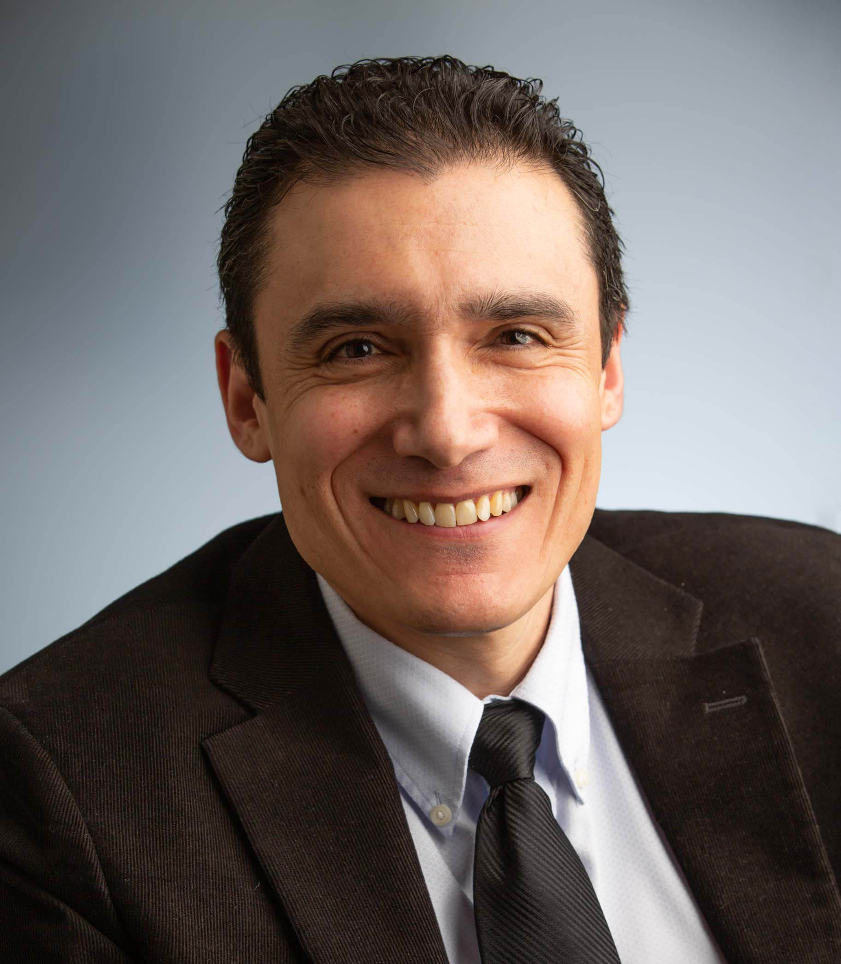
Authors
SOFTWARE QUALITY CONFERENCE
PACIFIC NW
Stefania Bruschi
Senior Software Engineer USC-ATRI
Le Xiao
Software Engineer
USC-ATRI
Mihir Kavatkar
Software Engineer
USC-ATRI
Gustavo Jimenez-Maggiora
Director of Informatics
USC-ATRI
Paul Stephen Aisen Professor of Neurology Director, Alzheimer's Therapeutic Research Institute
USC-ATRI
PNSQC ™

Slide 28
Thank you Q&A
SOFTWARE QUALITY CONFERENCE
PACIFIC NW
https://keck.usc.edu/atri/
We are hiring!
PNSQC ™

